Slide 1

Note: The data and information in this document is reflective of a hypothetical situation and client. This document is to be used for KPMG Virtual Internship purposes only.
Sprocket Central Pty Ltd
Data analytics approach
[Division Name] - [Engagement Manager], [Senior Consultant], [Junior Consultant]

Slide 2
Note: The data and information in this document is reflective of a hypothetical situation and client. This document is to be used for KPMG Virtual Internship purposes only.
Agenda
Introduction
Data Exploration
Model Development
Interpretation

Slide 3
Note: The data and information in this document is reflective of a hypothetical situation and client. This document is to be used for KPMG Virtual Internship purposes only.
Introduction
Identify and Recommend Top 1000 Customers to target from Datasets
Outline of problem
Customers data analysis
Sprocket Central is a company that specialized in high quality bikes and cycling accessories
Their marketing team is looking to Boost business sales by analyzing provided datasets
The aim is to analyze and recommend 1000 customers That sprocket central should target to drive higher value for the company
Age distributions
Number of bike purchases in 3 years / percentages purchases
Job industry category.
Wealth segments
Number of cars own on each states
Rfm Analysis and Customer Classification

Slide 4
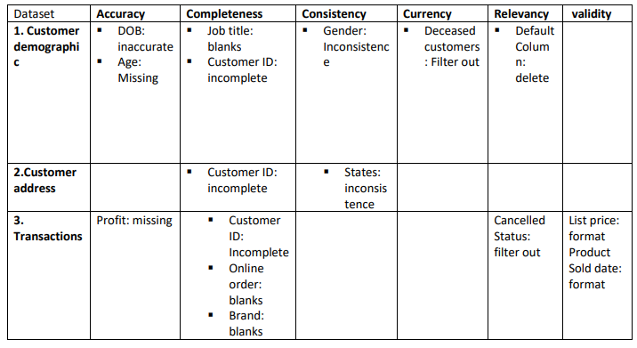
Note: The data and information in this document is reflective of a hypothetical situation and client. This document is to be used for KPMG Virtual Internship purposes only.
Data Exploration
Data quality Assessment and “Cleanup”
Accuracy: Correct Values
Completeness: Data fields with values
Consistency: Values free from contradiction
Currency: Values Up to date
Relevancy: Data items valuable data
Validity: Data Containing allowable values
Uniqueness
An in depth analysis has been sent via email,

Slide 5
Note: The data and information in this document is reflective of a hypothetical situation and client. This document is to be used for KPMG Virtual Internship purposes only.
Data Exploration
new
Customers’ age distribution
Most customers are aged between 40-49. In “old” majority of the customers are aged between 25-30 years.
The Lowest age groups are under 20 and 80+ for both new and old customer list.
The old customer list suggests 25-60
The new customer list suggests that the age groups 30-40 and 40-50 are most populated.
old

Slide 6
Note: The data and information in this document is reflective of a hypothetical situation and client. This document is to be used for KPMG Virtual Internship purposes only.
Data Exploration
Job Industry Distribution
20% of the new customers are In manufacturing and financial services
The Lowest number of the customers are from agriculture and It sector.
In old and new customer list, Financial Sector always comes up with the highest Position.

Slide 7
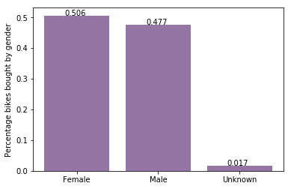
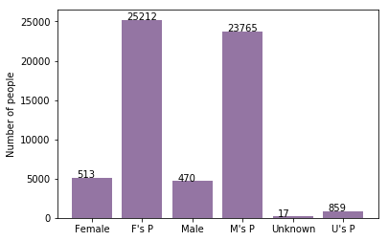
Note: The data and information in this document is reflective of a hypothetical situation and client. This document is to be used for KPMG Virtual Internship purposes only.
Data Exploration
Bike purchases last 3 years
As we can see, our new customers mostly Female with 50.6% purchases with total of 25,212 bikes
Male contributed to 47.7% purchases with 23,765 bikes
So we should focus on advertises on Female customers than Male customers

Slide 8
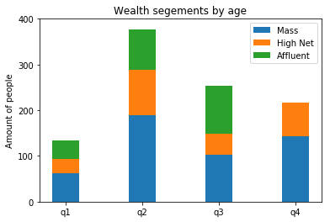
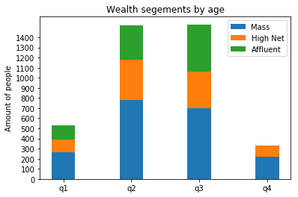
Note: The data and information in this document is reflective of a hypothetical situation and client. This document is to be used for KPMG Virtual Internship purposes only.
Data Exploration
Wealth segments
In all ages, the number of Mass Customers is the highest so we should focus on this social class.
After that, we should focus on High Net Customer.
Then Affluent Customers but mostly second and third quadrant

Slide 9
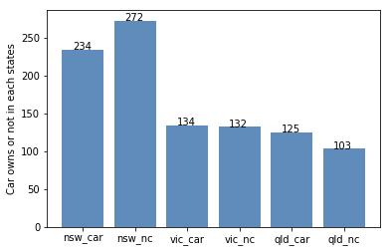
Note: The data and information in this document is reflective of a hypothetical situation and client. This document is to be used for KPMG Virtual Internship purposes only.
Data Exploration
Numbers of cars owned
NSW should be considered the most since numbers of customers don’t own cars is significantly larger than that own.
VIC and QLD has more customers that own car that who don’t but we can try to have something so that those owns car will buy bikes.

Slide 10
Note: The data and information in this document is reflective of a hypothetical situation and client. This document is to be used for KPMG Virtual Internship purposes only.
Model Development
RFM Analysis and Customer Classification
Rfm Analysis is used to determine which customers a business should target to increase its revenue and value
It shows customers that have displayed high levels of engagement with the business in the four categories mentioned.

Slide 11
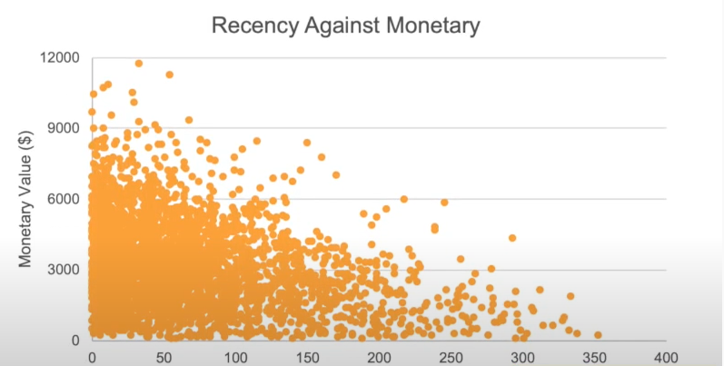
Note: The data and information in this document is reflective of a hypothetical situation and client. This document is to be used for KPMG Virtual Internship purposes only.
Interpretation
Scatter Plot Based Off RFM Analysis
The chart shows that customers who purchased more recently have generated more revenue, than customer who visited while ago.
Those who vested more than 200 days ago generated low revenue,

Slide 12
Note: The data and information in this document is reflective of a hypothetical situation and client. This document is to be used for KPMG Virtual Internship purposes only.
Appendix

Slide 13
Note: The data and information in this document is reflective of a hypothetical situation and client. This document is to be used for KPMG Virtual Internship purposes only.
Appendix
All supporting items in that attachment.

